Slide 1
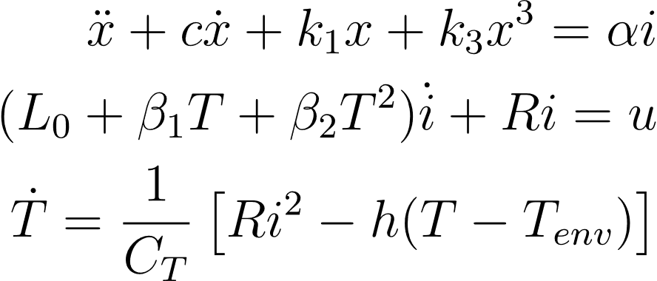
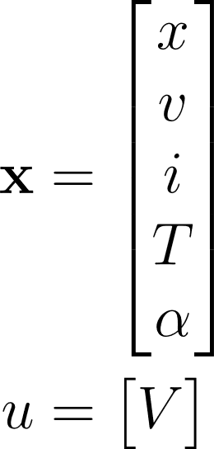
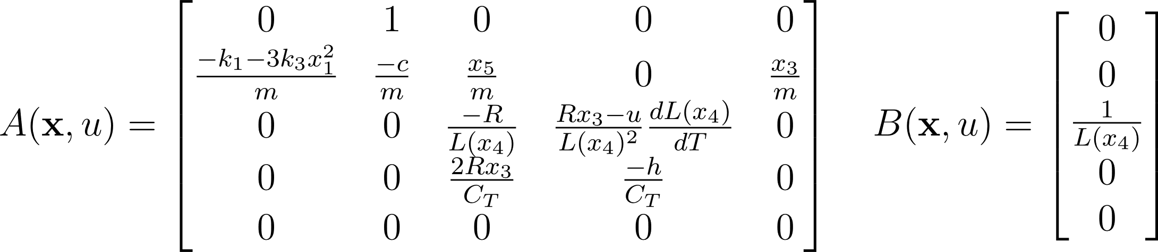
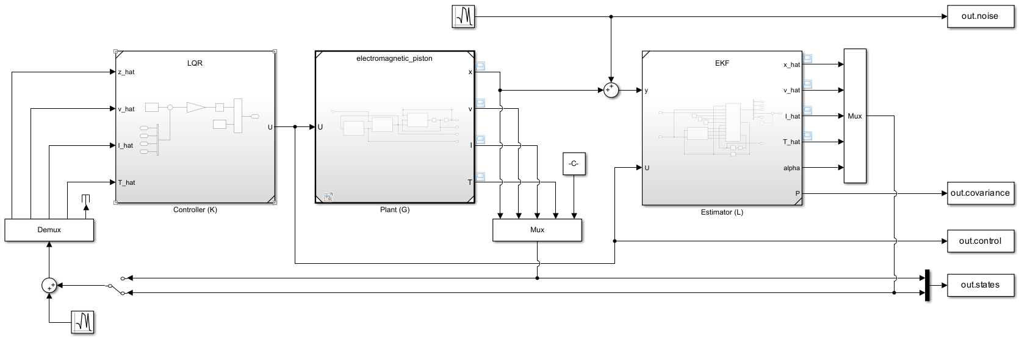
Parameter estimation via EKF
Implementation of an Extended Kalman Filter (EKF) to estimate the unknown value of a parameter of the system.
For the design of the EKF, we considered the augmented system with the additional state $α$ (parameter be identified). The update of the estimates is based only on $x_{1}$. Different values for both $P_{0,EKF}$, $Q_{EKF}$ and $R_{EKF}$ were considered to observe their effects on the filter operation.

Slide 2
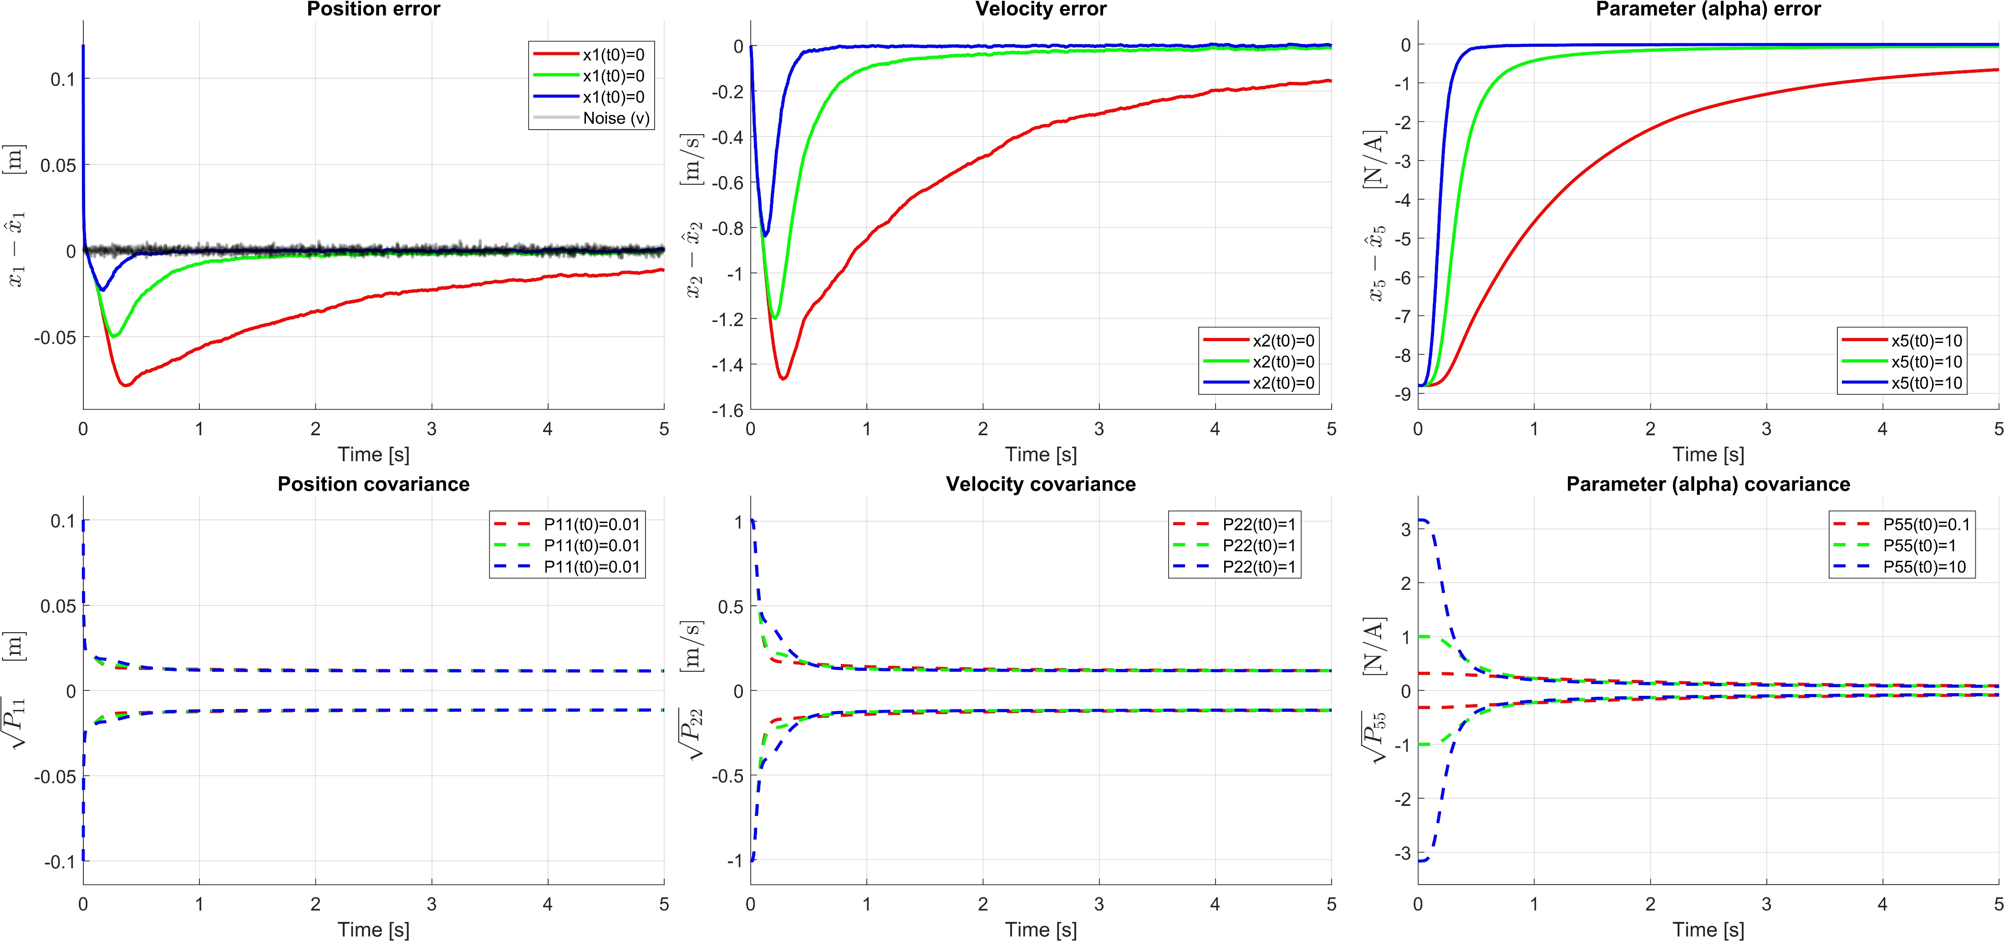
Influence of $P_{0}(5, 5)$, keeping $Q\left(5, 5\right)=0$, $R={10}^{−5}$
Larger $P_{0}$ helps in reaching correct estimation in a shorter time. Too high values might lead to strong initial fluctuations.

Slide 3
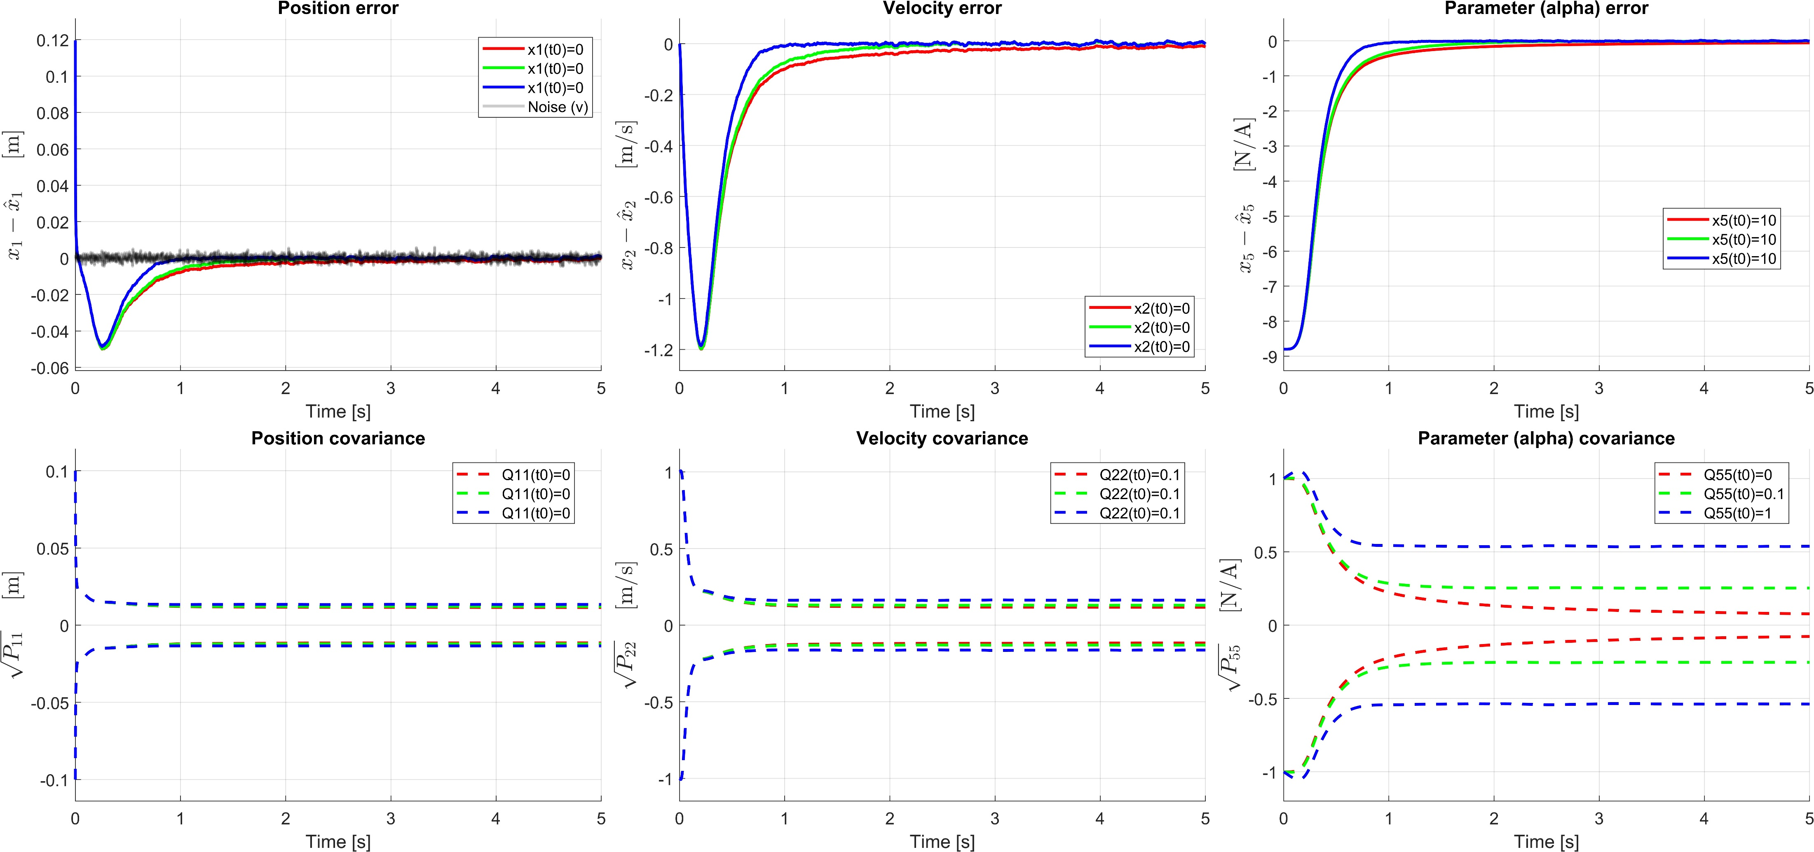
Influence of $Q(5, 5)$, keeping $P_{0}\left(5, 5\right)=1$, $R={10}^{−5}$
Larger $Q$ helps to trust measurement more but leads to lower confidence in estimation.

Slide 4
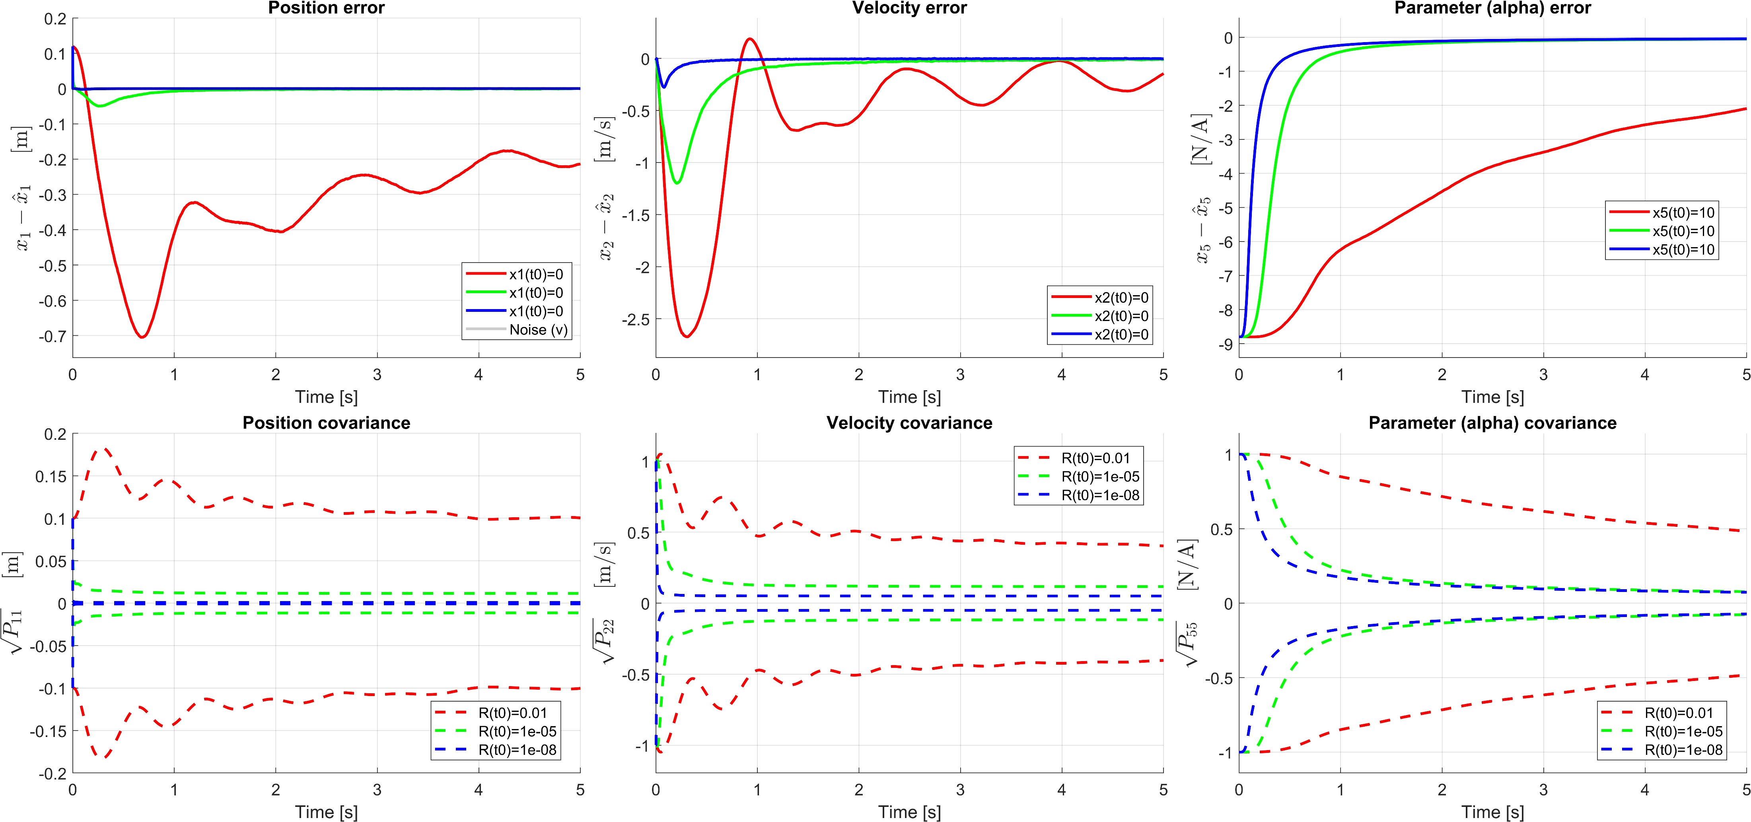
Influence of $R$, keeping $P_{0}\left(5, 5\right)=1$, $Q\left(5, 5\right)=0$
Smaller $R$ helps to trust measurement more but also reduces smoothing capabilities of the filter. On the other hand, larger $R$ forces the filter to rely more on the model and thus also on the initial estimate, which may be wrong, imposing long times before a correct estimate is obtained.

